Slide 1



Music Recognition system
Using “Open Ai
Group 5
Ankit varma – 23MAS10016
Kotla Praveen – 23MAS10036
Bianka Thomas – 23MAS10013
Srinivas K M – 23MAS10012

Slide 2
Content
Introduction
Open AI
API key
Large Language model
Implementation
Output

Slide 3

Introduction
Music recognition system leveraging OpenAI's powerful GPT-3.5 architecture.
This innovative project aims to revolutionize how we interact with music, enabling seamless identification of genres, artists, and titles.
Harnessing the capabilities of OpenAI, our system promises an immersive and accurate musical experience for users in today's dynamic digital landscape.

Slide 4
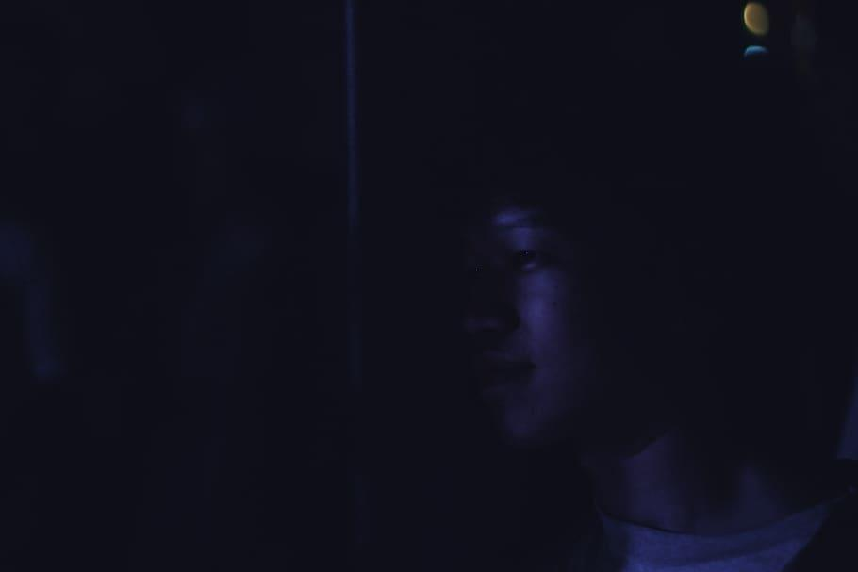
Open AI
OpenAI stands at the forefront of artificial intelligence, boasting the powerful GPT-3.5 architecture.
Functioning as a language model, it excels in natural language understanding and generation.
OpenAI's capabilities extend to diverse applications, from text completion to language translation, content creation, and problem-solving
By harnessing OpenAI's functionalities, we unlock doors to creativity, efficiency, and novel solutions in the ever-evolving landscape of artificial intelligence.

Slide 5
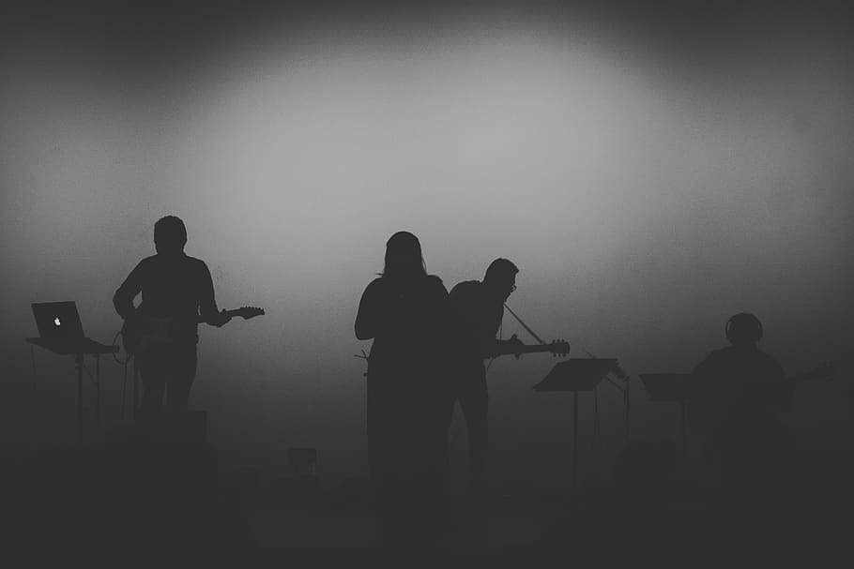
API key
An API key is a unique identifier that grants access to a specific set of functionalities or data within an application programming interface.
It serves as a secure authentication token, allowing developers to make authorized requests and access protected resources.
This key acts as a digital passcode, ensuring that only authorized users or applications can interact with the associated API, safeguarding data and maintaining system integrity.

Slide 6
Large Language model”LLM”
These are sophisticated artificial intelligence models designed to understand and generate human-like text. Notable examples .
Include GPT-3, developed by OpenAI, which can perform various language-related tasks, such as text completion, translation, and content creation..
LLMs are pivotal in natural language processing, significantly impacting fields like machine learning, AI research, and diverse applications in technology.

Slide 7
Implementation
- Developed a music recommendation system using OpenAI's GPT-3.5 Turbo.
- Utilized Colab for coding efficiency and installed necessary packages like 'cohere' and 'tiktoken.'
- Integrated OpenAI API key for secure authentication.
- Created a user-friendly chat interface to interact with the model.
- Demonstrated system functionality, recommending music based on user input.
- Ensured a seamless experience with continuous user interaction until exit command.
- Explored version control using 'openai==0.28.'
- Simplified and optimized code for effective presentation.

Slide 8
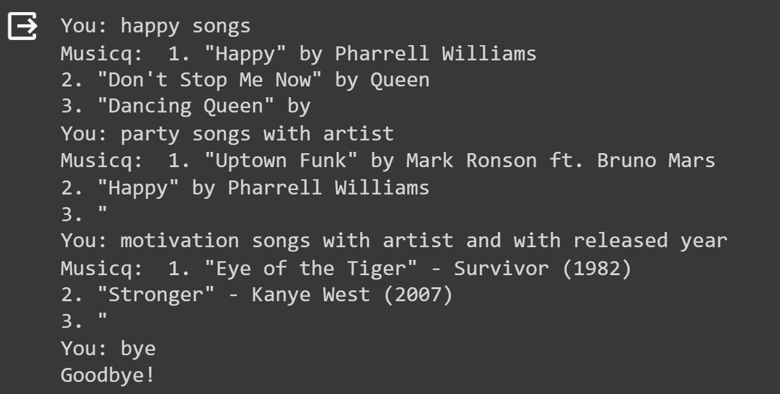
Output

Slide 9
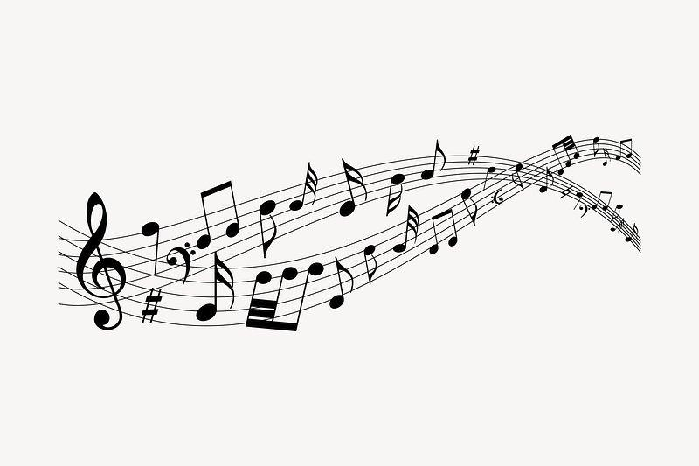
Thank
you

